Slide 2
Family & Community Education Fund
A member mobilization tool

Slide 3
Agenda
What is the Fund?
Who can access it?
Funding Criteria
What Can it Do?
Project Brainstorming
Family Care Reimbursement
Q&A

Slide 4
What is it?
A grant program that funds USW initiatives of any size that support Steelworker families, promote USW in the community, and/or engage new and/or young activists.
Notes:
contributors remit 1% total dues already collected; funds Steelworker Summer, Young Workers Awareness Program, national Be More Than a Bystander Program but also more localized events
What Funded events have you hosted or heard about?

Slide 5
FCEF History
1989 : National education fund transformed
1995 : FCEF’s mandate broadened
2019 : Fund re-animated, Fund Coordinator hired
2019 : National resolution to further strengthen Fund
Notes:
In 1989, our national director turned the previous education fund contributed to into one that explicitly supports family education
In 1995, at the National Policy Conference, a resolution was passed to broaden the fund’s mandate, specifically to ensure that it is:
“oriented towards involving the families of Steelworker members in the educational life of the organization[..] and helping to identify and develop new activists.”
2019 resolution aims to further strengthen and promote the Fund:
“…THEREFORE BE IT RESOLVED THAT the Union actively promote the USW’s FCEF in all Canadian districts as a powerful way for locals to help Steelworker families, and to become involved in our communities and engage with new members and young activists; and
BE IT FURTHER RESOLVED THAT the Union encourage all non-contributing locals to join the FCEF so that they can develop their own similar activities while also benefiting from the FCEF’s contributions and resources; and
BE IT FINALLY RESOLVED THAT the Steelworkers support and equip our member facilitators so that they can prepare and deliver the educational component needed for many of the FCEF’s family and community educational activities.”
The Fund was re-animated in 2019 with the hiring of a Fund Coordinator and the initiation of an open period for all locals, regardless of if they contribute
Closed to contributors since July 2020 – contributors remit 1% total dues already collected; to sign on, pass a motion at your GMM and complete a dues check-off form

Slide 6
Committee & Review Structure
Advisory Committee: meets annually
Advises on strategy, staffing, big picture items re. Fund & its maintenance
Project Review Committee: meets quarterly
Reviews project submissions over $5,000
District Education Coordinators: ongoing
Review District project submissions under $5,000
Notes:
AC constitutes: a staff rep, local union rep, and education coordinator from each district; the national director’s admin assistant, Alex, and his assistant, Mark; the CNO Education & Equality department leader; and the Fund Coordinator
PRC constitutes: a local union rep and education coordinator from each district; the national director’s admin assistant, Alex, and the Fund Coordinator
Decisions on large projects will be made quarterly based on the impact of the project, the extent to which it promotes one or more of the theme areas, and the funds available in the given quarter. The goal is that no submission is denied – re-submissions are always welcome!

Slide 7
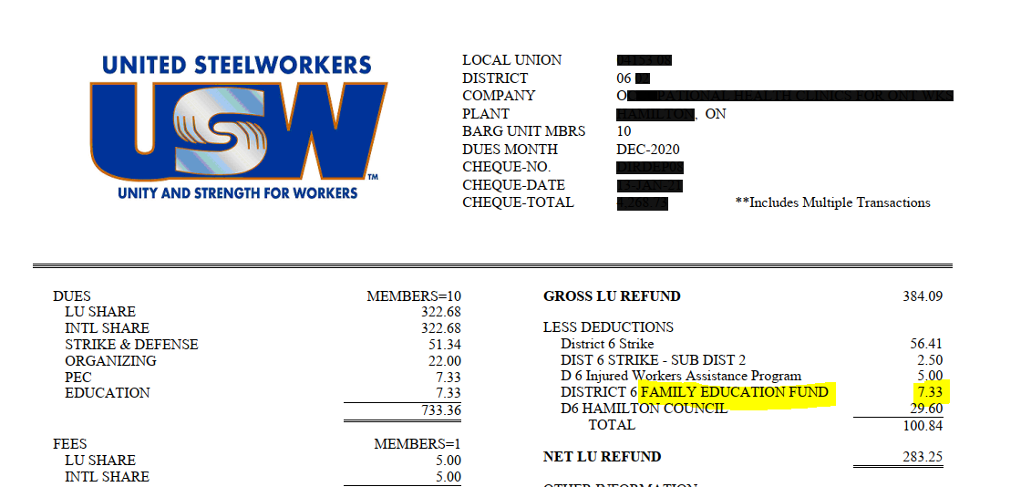
Does My Local Contribute? - Dues Mailer
Notes:
Area Councils & Committees can also apply! Communal initiatives must support wide group of members and/or neighbours, not just one local specifically

Slide 8
Joining the Fund
NO extra cost to members
1% of dues already collected will be remitted by the International to the FCEF
Steps:
LU passes motion at membership meeting
Complete Check-off Authorization Form
Make immediate use of the Fund!

Slide 9
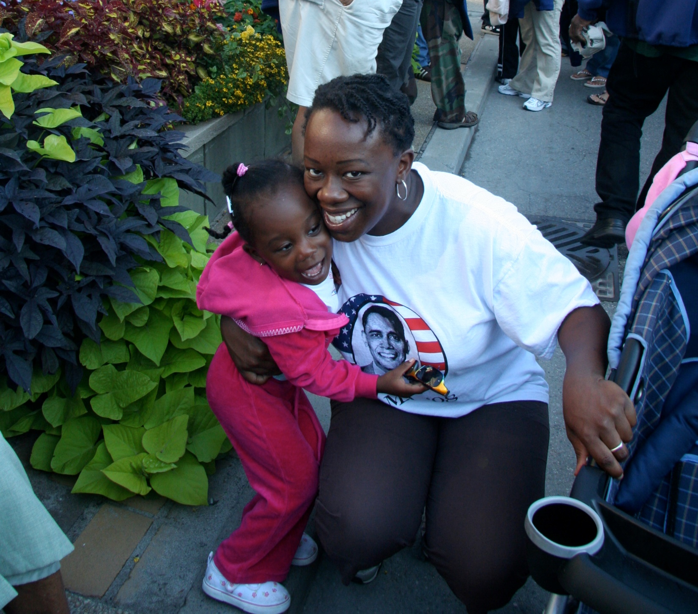
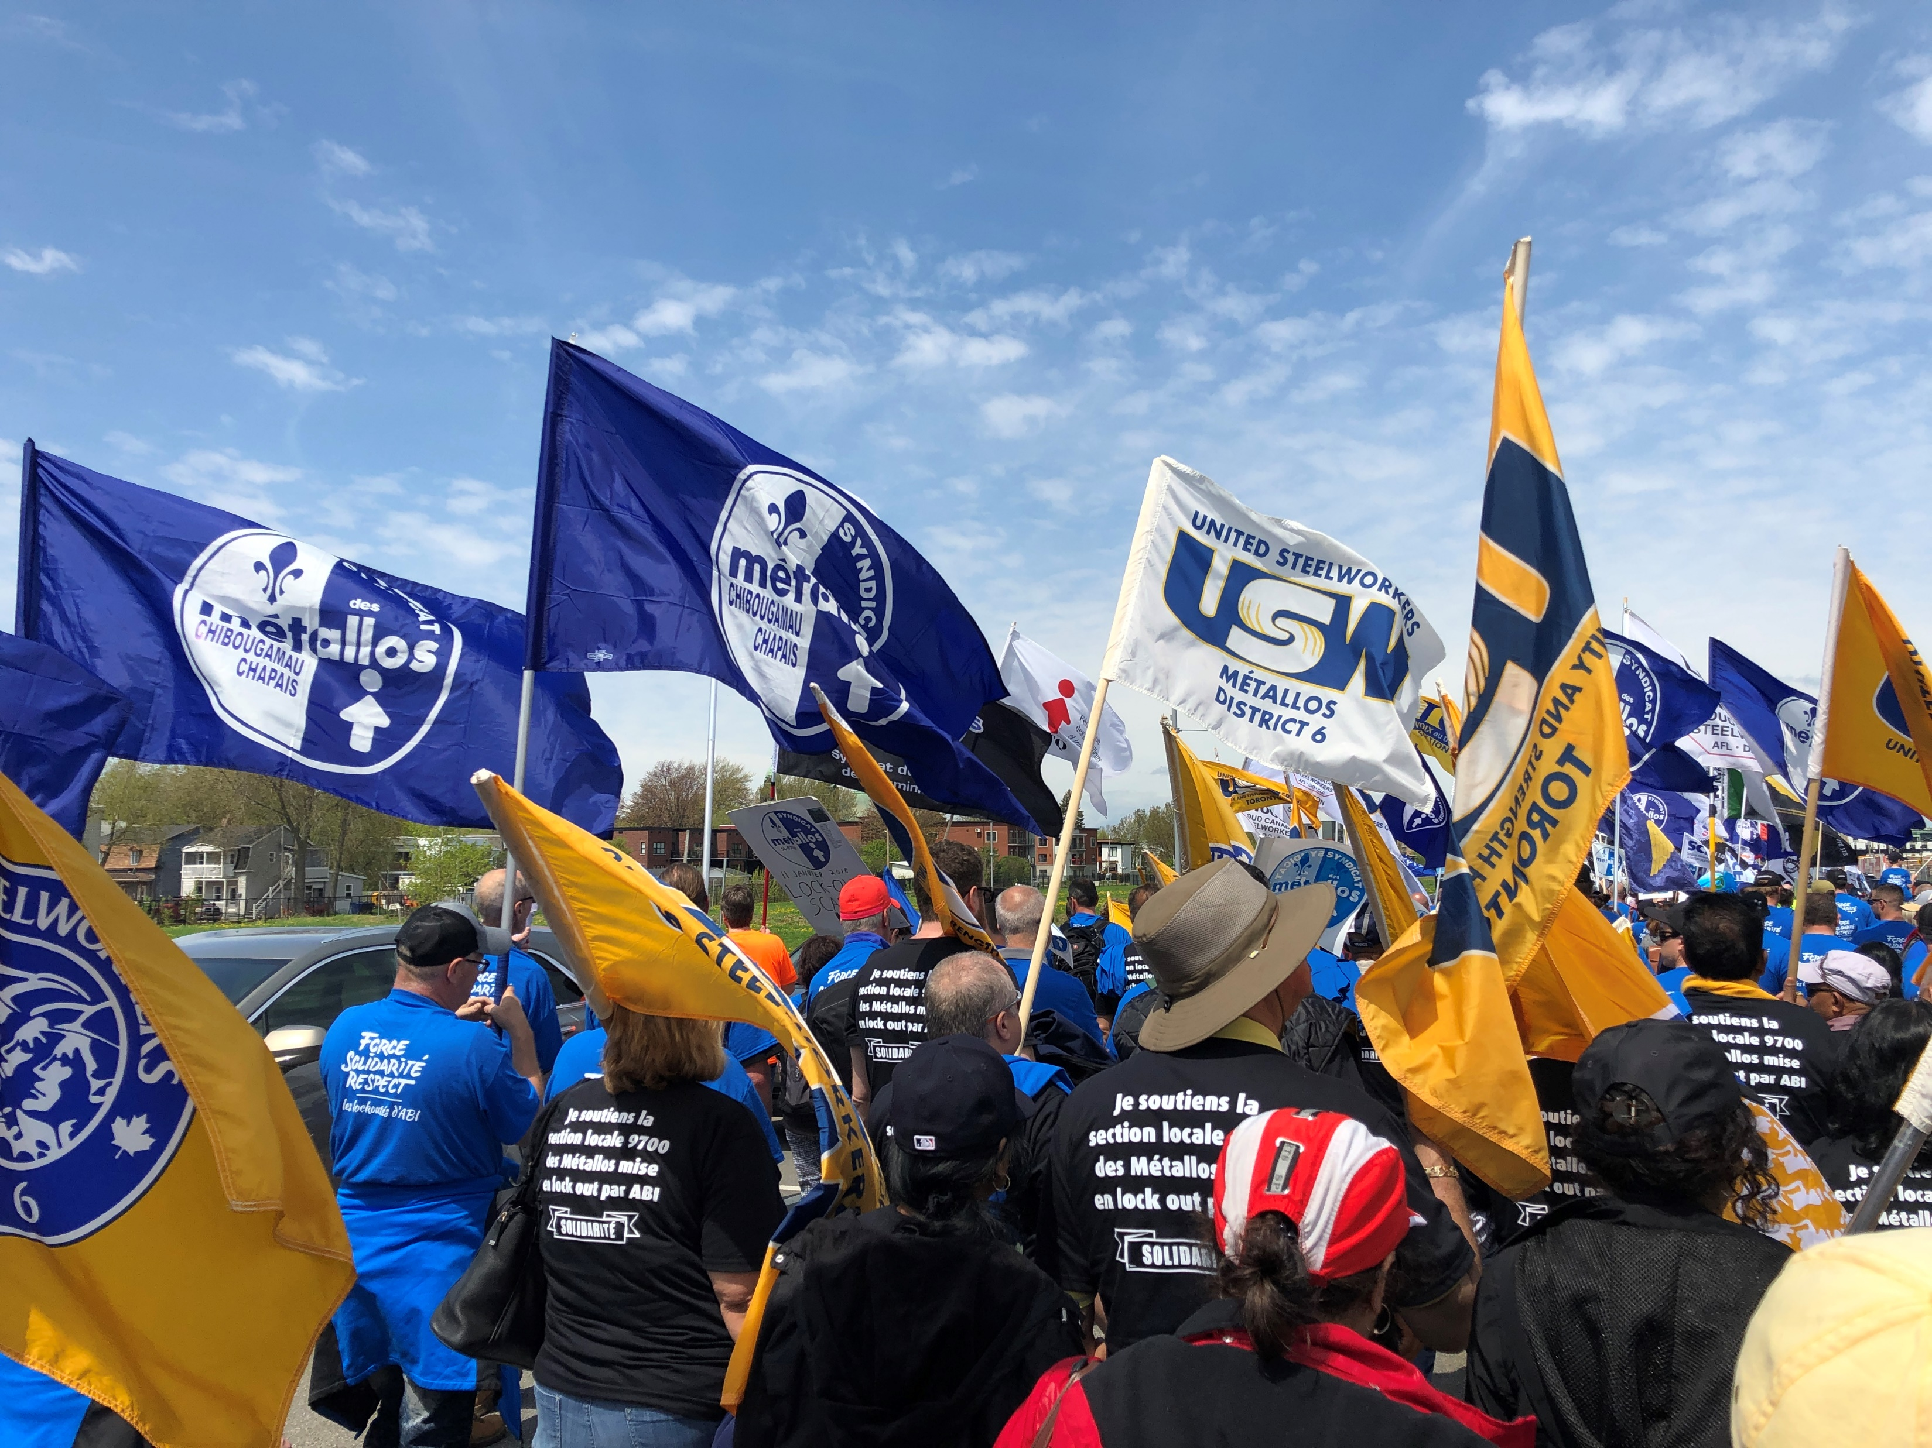
FCEF Themes & Criteria
Does not fund: physical assets; fundraisers; past events.
Education component required!
Notes:
Must meet at least 1 pillar:
Supporting Steelworker Families
Promoting USW in the community
Supporting/identifying/engaging YOUNG activists
Supporting/identifying/engaging NEW activists
Very open to creative programming – think outside of the box!
Education must be ACTIVE, can’t be giving out flyers – should be something that requires active participation/experiential learning
-
Decisions on large projects will be made quarterly based on the impact of the project, the extent to which it promotes one or more of the theme areas, and the funds available in the given quarter. The goal is that no submission is denied – re-submissions are always welcome!
-
AC constitutes: a staff rep, local union rep, and education coordinator from each district; the national director’s admin assistant, Alex, and his assistant, Mark; the CNO Education & Equality department leader; and the Fund Coordinator
PRC constitutes: a local union rep and education coordinator from each district; the national director’s admin assistant, Alex, and the Fund Coordinator

Slide 10
Why the FCEF?
Strengthens the local
Boosts member engagement
Energizes and identifies union activists
Increases community support
Notes:
Stronger together – contributing to the Fund helps smaller locals access more funds than they otherwise could have – union solidarity!
Long-term impacts – Fund’s educational requirement ensures participants’ active learning, meaning they’ll carry what they’ve learned to share with family, friends, and neighbours
ACTIVE learning: To really learn something, need to be actively involved, engaged -> just listening doesn’t help with understanding, need participants more involved in the learning experience to recall it later -> hands on = mind’s on ; reinforce education through taking action

Slide 11
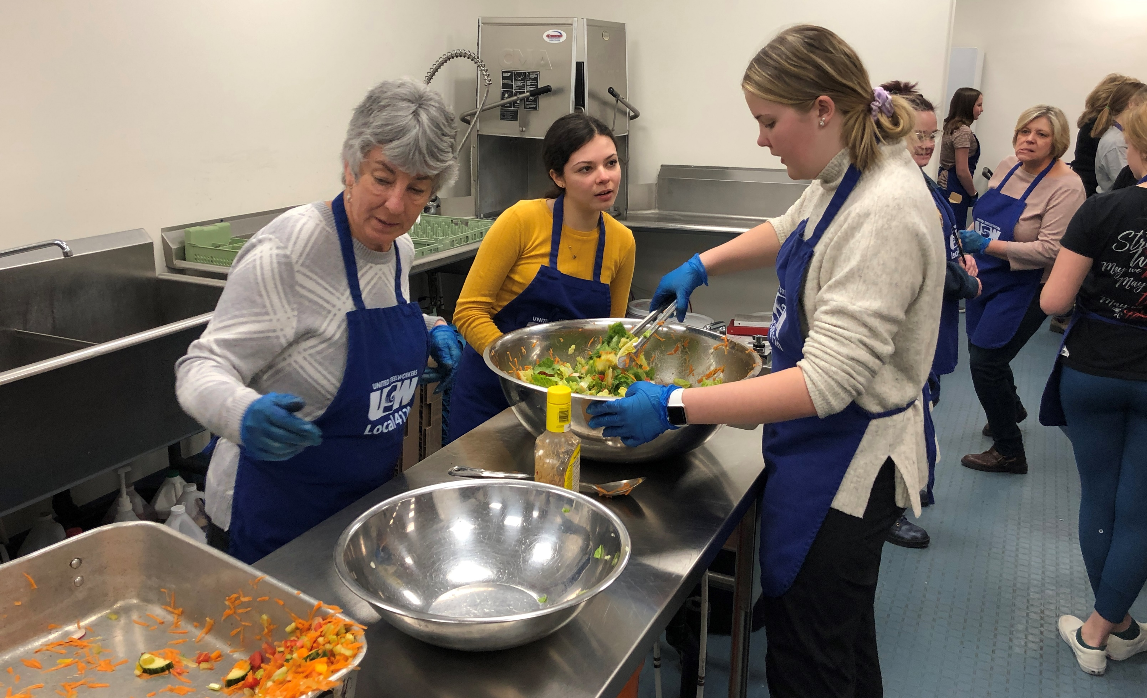
Funded events “get members out, doing something they wouldn’t normally do.”
Notes:
“Almost limitless.” “Bringing something back to community.”
Guaranteed engagement – contributors have identified Funded events as being a sure way of drawing members to the union that otherwise wouldn’t attend local events like general meetings

Slide 12
FCEF & Equity-Seeking Groups
Funds initiatives that support underrepresented groups:
NextGen
Women
LGBTQ+
Racialized workers
Notes:
The events you host affects how your membership & community perceive your local – when you host events specifically for underrepresented members, those folks begin to feel represented, welcome, and inspired by their locals and area councils. These folks then begin to take up more leadership opportunities and get involved in things like bargaining!

Slide 13
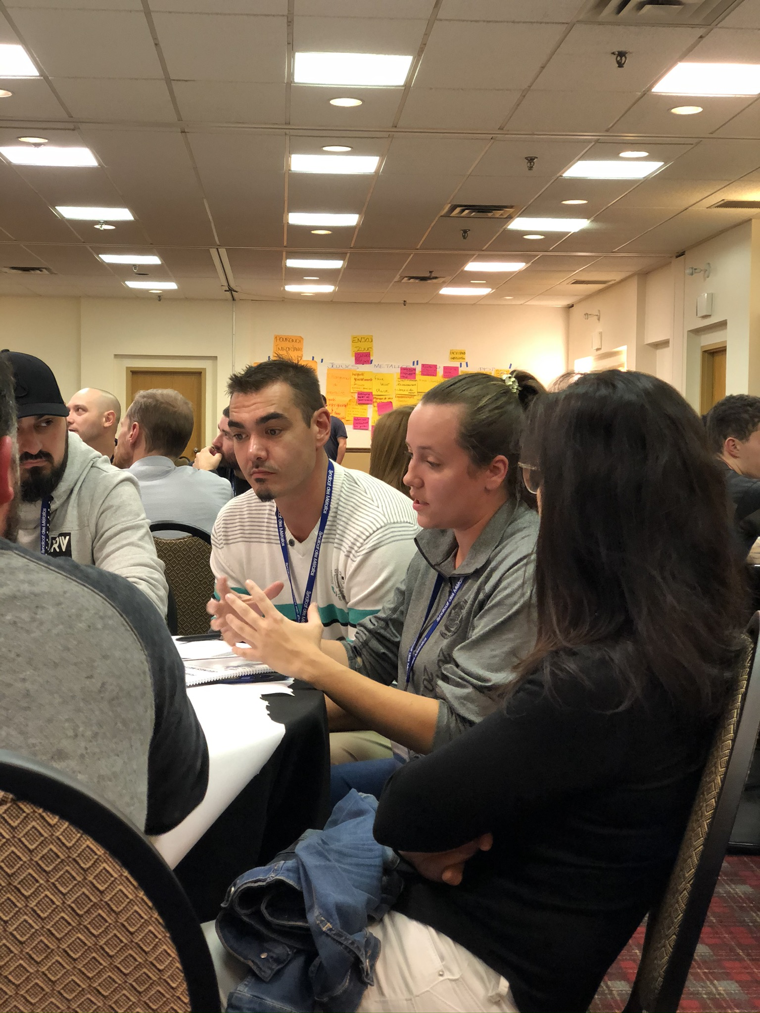
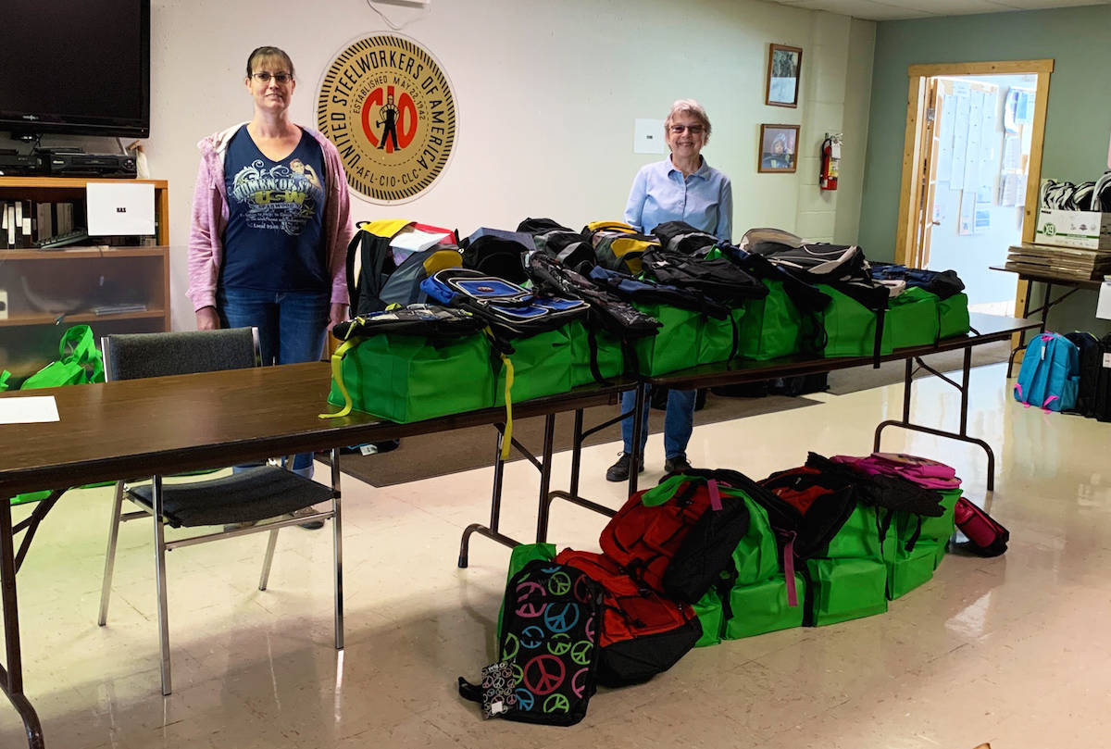
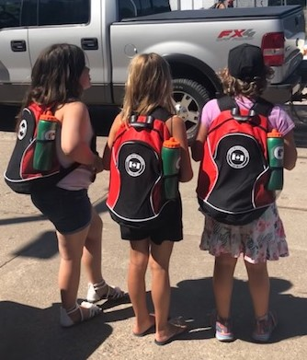
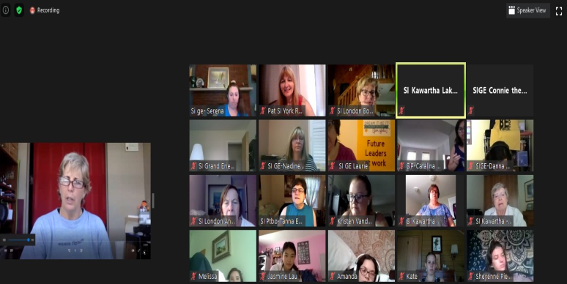
Past Events
9346
D5
2251
8782
Notes:
Also have done an injured worker webinar series put on by the NWOAC and neighbouring labour organizations; local history archive project; and more

Slide 14
Scenario 1:
Your membership is really disengaged and there are lots of vacancies on your committees.
What are some project ideas that you could get Funding for that would engage your membership and keep them involved in your local?

Slide 15
Scenario 2:
There have been layoffs in your local, and members’ morale is low.
What event or project could you submit to the FCEF that would support members and their families during this tough time?

Slide 16
Scenario 3:
Your local’s in bargaining this year and wants to foster support from the community, in case a strike or lockout happens.
What are some projects or events you could host with funding from the FCEF to increase your local’s visibility and deepen relationships with your non-Steelworker neighbours?

Slide 17
Scenario 4:
Your local wants to put on a family fun day for Labour Day – what are some education components you could easily include?

Slide 18
Family Care
FCEF now reimburses extra family care costs incurred by Steelworkers attending authorized union activities!
Notes:
Great way to increase the participation of those who typically opt out of off-hour union events in order to provide family care to loved ones – includes children and dependent adults, including those living with disabilities

Slide 19
Family Care
Eligible dependent(s):
Child under 17
Person with disability
Dependent adult requiring care
Costs incurred outside of normal working hours (up to $19.50/hr)
Members directly reimbursed
Notes:
People’s care circumstances are different, so they can reach out to me to discuss their unique circumstances, should they, for example, find their care costs exceed the cost of the amount identified by the FCEF.
Can include care for overnight trips as well, up to $270
* Add this to your website so your members with family care responsibilities can see and feel they’re represented by your local

Slide 20
Get in Touch
Gabriele Simmons
Fund Coordinator
All FCEF queries, for projects over $5,000
519 803-0848
gsimmons@usw.ca

Slide 21
Quick Links
How to Join: https://bit.ly/3qjgWn4 / https://bit.ly/2SJmWJt
Project Ideas: https://bit.ly/3gK3NPe / https://bit.ly/3vJH8bp
Sample FCEF application: https://bit.ly/3gKXCMk / https://bit.ly/2UfU0Je
Application tips: https://bit.ly/3gL9VHa / https://bit.ly/35HZ3EM
Application Form: https://bit.ly/3gL1Q6x / https://bit.ly/3wO6p5s
Family Care Reimbursement: https://bit.ly/2Shdixn / https://bit.ly/2UfUFuc
Notes:
There are many resources to help you with coming up with project ideas and applying for funds! If you’ve got ideas for other items that would be of help to applicants, reach out.

